Slide 1

Web/iOS Development
Shyne
2014.10.20

Slide 2

Today
Questions?
Let’s talk a little bit about the projects
More examples for Array and dictionary
Object graph and memory management
iOS human interface guidelines

Slide 3
[Object graph]

Slide 4
Objects and memory
Memory for Objective-C objects is allocated dynamically on the heap, which means you need to use pointers to keep track of an object’s address.
Unlike scalar values, it’s not always possible to determine an object’s lifetime by the scope of one pointer variable. Instead, an object must be kept active in memory for as long as it is needed by other objects.
Rather than trying to worry about managing the lifecycle of each object manually, you should instead think about the relationships between objects.

Slide 5
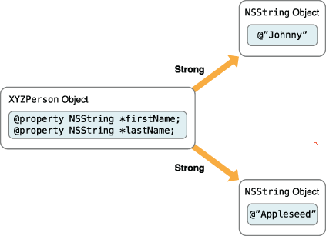
Objects and memory
When one object relies on other objects in this way, effectively taking ownership of those other objects, the first object is said to have strong references to the other objects. In Objective-C, an object is kept alive as long as it has at least one strong reference to it from another object.

Slide 6
Objects and memory
When one object relies on other objects in this way, effectively taking ownership of those other objects, the first object is said to have strong references to the other objects. In Objective-C, an object is kept alive as long as it has at least one strong reference to it from another object.

Slide 7
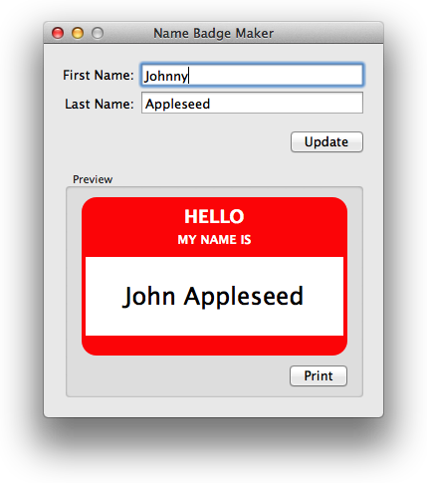
The name badge maker application
Question: what UI components in this app?
When the user clicks the Update button, the badge preview is updated with the relevant name information.

Slide 8
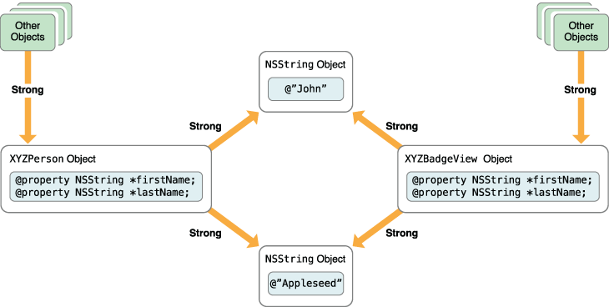
Objects and memory
The first time a person’s details are entered and the update button clicked, the simplified object graph looks like

Slide 9
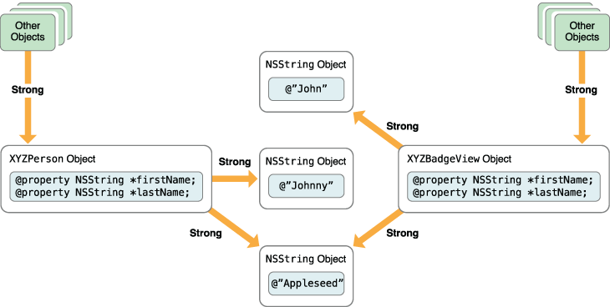
Objects and memory
When the user modifies the person’s first name, the object graph changes to look like

Slide 10
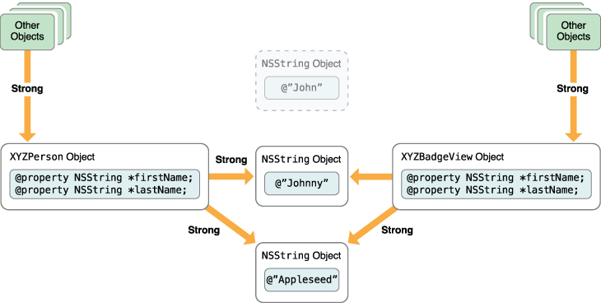
Objects and memory
Once the user clicks the Update button again, the badge view is told to update its internal properties to match the person object, so the object graph looks like

Slide 11
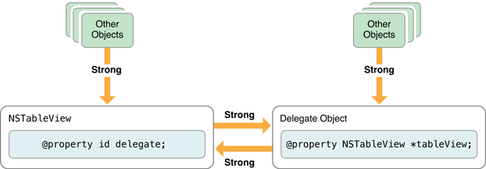
Strong reference cycles
Strong references work well for one-way relationships between objects. However, be careful when working with groups of interconnected objects.
If a group of objects is connected by a circle of strong relationships, they keep each other alive even if there are no strong references from outside the group and create a memory leak

Slide 12
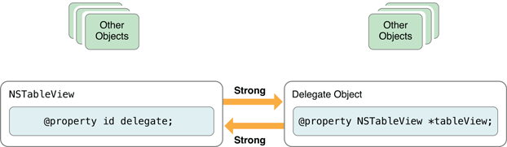
Strong reference cycles
What memory leak is bad?
ARC
  Automatic Reference Counting (ARC) is a memory management enhancement where the burden of keeping track of an object's reference count is lifted from the programmer to the compiler
  Objects are released when the reference count == 0

Slide 13
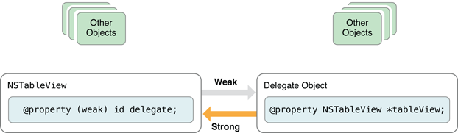
How to fix the strong reference cycles?
In @property, use “weak”
When weak is specified, the object reference count will NOT be incremented
99% of the time, delegate has to be “weak”
Also all the IBOutlets must be “weak”

Slide 14
[iOS human interface guidelines]

Slide 15
Designing for iOS
Defer to content
  Take advantage of the whole screen
  Reconsider visual indicators of physicality and realism
    Use less bezels, gradients and drop shadows
  Let translucent UI elements hint at the content behind them.
    A single UIVisualEffectView object with a blur effect.

Slide 16
Designing for iOS
Provide clarity
  Use plenty of negative space.Reconsider visual indicators of physicality and realism
  Let color simplify the UI. A key color—such as yellow in Notes—highlights important state and subtly indicates interactivity.
  Ensure legibility by using the system fonts.
    Whether you use system or custom fonts, be sure to adopt Dynamic Type so your app can respond when the user chooses a different text size.
  Embrace borderless buttons

Slide 17
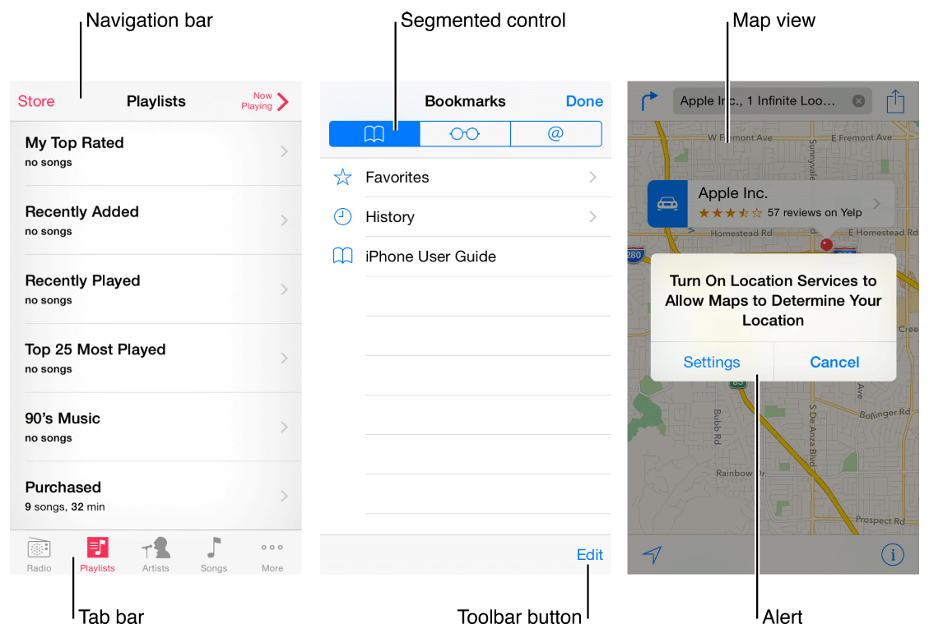
iOS app anatomy

Slide 18
Navigation
Broadly speaking, there are three main styles of navigation, each of which is well suited to a specific app structure:
  Hierarchical
  Flat
  Content- or experience-driven

Slide 19

Navigation - hierarchical
In a hierarchical app, users navigate by making one choice per screen until they reach their destination.

Slide 20
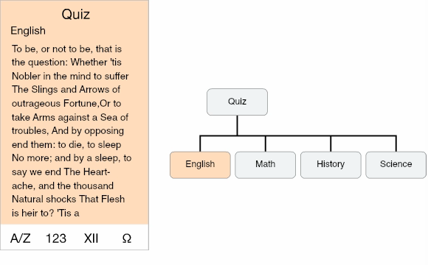
Navigation - flat
Users can navigate directly from one primary category to another because all primary categories are accessible from the main screen

Slide 21
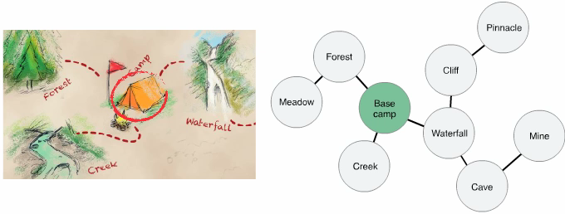
Navigation - Content- or experience-driven
in an app that uses a content- or experience-driven information structure, navigation is also defined by the content or experience.

Slide 22
Navigation
Users should always know where they are in your app and how to get to their next destination.
Use a navigation bar to give users an easy way to traverse a hierarchy of data.
Use a tab bar to display several peer categories of content or functionality.
Use a page control when each app screen represents an individual instance of the same type of item or page
In general, it’s best to give users one path to each screen

Slide 23
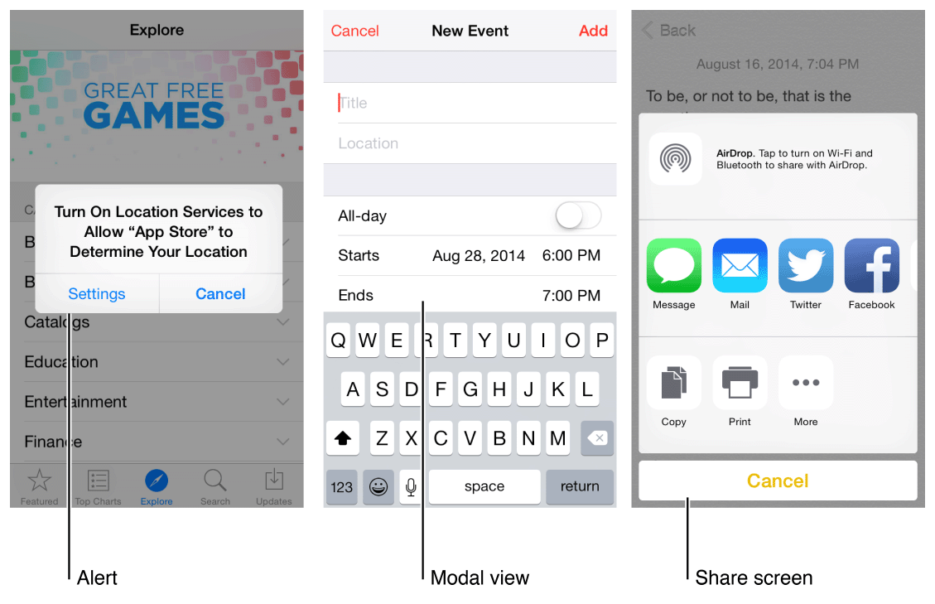
Modal Contexts
Modal view give users a way to complete a task or get information without distractions, but it does so by temporarily preventing them from interacting with the rest of the app.

Slide 24
Modal views
In general, consider creating a modal context only when:
  It’s critical to get the user’s attention
  A self-contained task must be completed—or explicitly abandoned—to avoid leaving the user’s data in an ambiguous state
Keep modal tasks simple, short, and narrowly focused
Always provide an obvious and safe way to exit a modal task
If the task requires a hierarchy of modal views, make sure your users understand what happens if they tap a Done button in a view that’s below the top level.
Reserve alerts for delivering essential—and ideally actionable—information
Respect users’ preferences for receiving notifications

Slide 25
Standard Gestures
Tap
Drag
Flick
Swipe
  4 fingers?
Double tap
Pinch
Touch and hold (long press)
Shake
https://developer.apple.com/library/ios/documentation/userexperience/conceptual/mobilehig/InteractivityInput.html#//apple_ref/doc/uid/TP40006556-CH55-SW1

Slide 26
Gesture guidelines
Avoid associating different actions with the standard gestures
Avoid creating custom gestures that invoke the same actions as the standard gestures
Use complex gestures as shortcuts to expedite a task, not as the only way to perform it.
In general, avoid defining new gestures unless your app is a game
In a regular environment, consider using multifinger gestures.

Slide 27
Interactive elements invite touch
To signal interactivity, the built-in apps use a variety of cues, including color, location, context, and meaningful icons and labels. Users rarely need additional decorations to show them that an onscreen element is interactive or to suggest what it does.

Slide 28
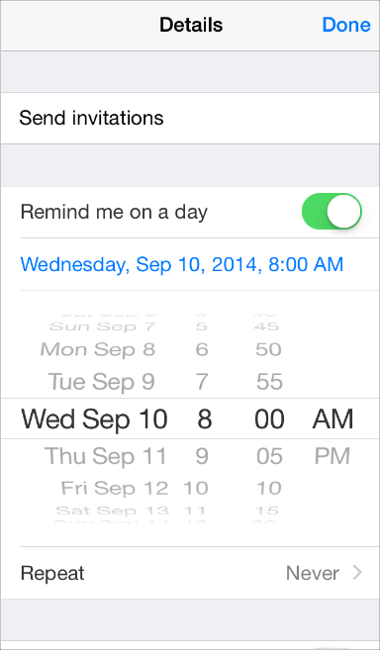
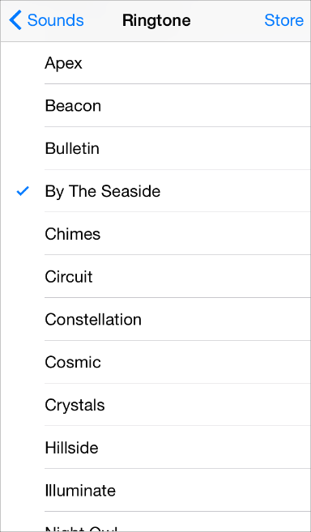
Inputting information should be easy
Make it easy for users to make choices

Slide 29
Animation
Beautiful, subtle animation pervades the iOS UI and makes the app experience more engaging and dynamic. Appropriate animation can:
  Communicate status and provide feedback
  Enhance the sense of direct manipulation
  Help people visualize the results of their actions

Slide 30
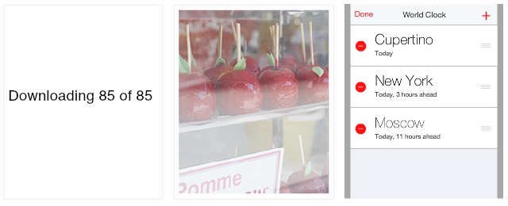
Animation

Slide 31
Animation
Add animation cautiously, especially in apps that don’t provide an immersive experience.
  In particular, use motion effects and UIKit dynamic behaviors with purpose and restraint, and be sure to test the results
When appropriate, make custom animation consistent with built-in animation.
  Scroll acceleration and deceleration
Use animation consistently throughout your app.
In general, strive for realism and credibility in custom animation
  People tend to be willing to accept artistic license in appearance, but they can feel disoriented when they experience movement that doesn’t make sense or appears to defy physical laws
https://www.youtube.com/watch?v=U-edAGLokak

Slide 32
Branding
Successful branding involves more than adding brand assets to an app. The best apps integrate existing assets with a unique look and feel to give users a delightful, memorable experience.
Incorporate a brand’s assets in a refined, unobtrusive way
Don’t take space away from the content people care about.
Resist the temptation to display your logo throughout the app.

Slide 33
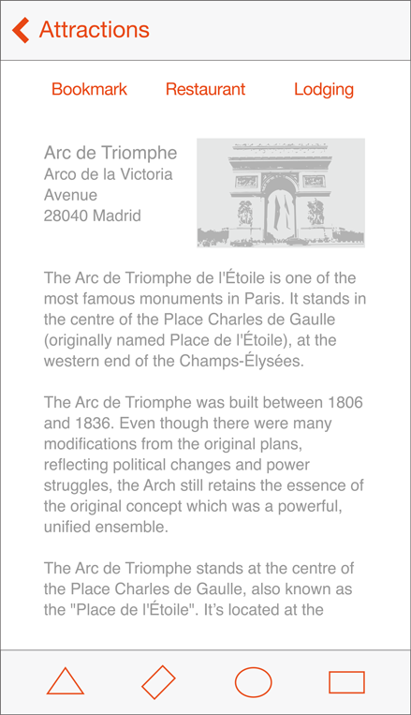
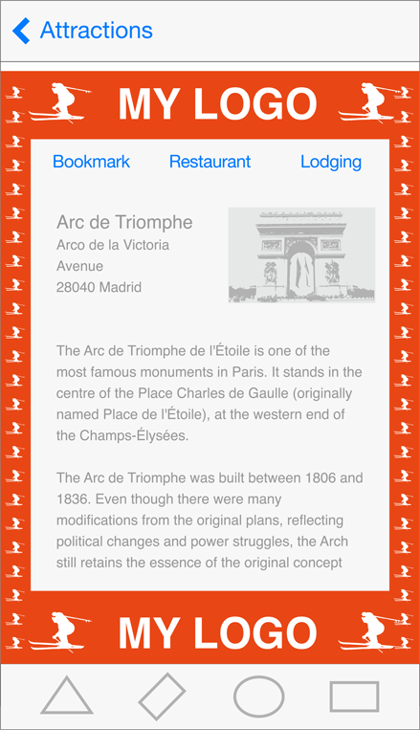
Branding

Slide 34
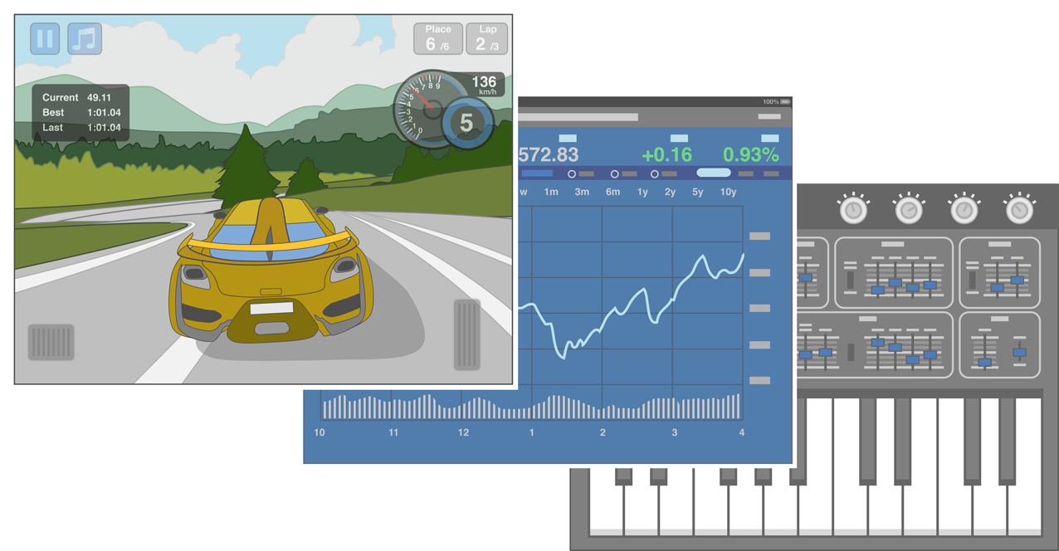
Design principles - aesthetic integrity
Aesthetic integrity doesn’t measure the beauty of an app’s artwork or characterize its style; rather, it represents how well an app’s appearance and behavior integrates with its function to send a coherent message

Slide 35
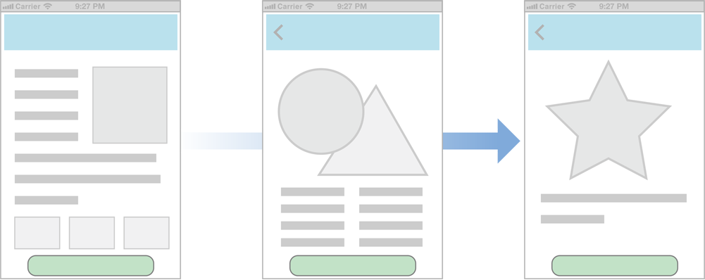
Design principles - consistency
Consistency lets people transfer their knowledge and skills from one part of an app’s UI to another and from one app to another app

Slide 36
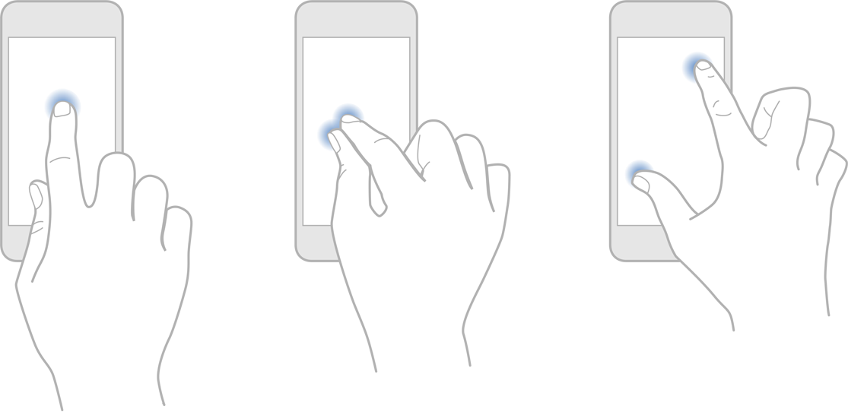
Direct manipulation
When people directly manipulate onscreen objects instead of using separate controls to manipulate them, they're more engaged with their task and it’s easier for them to understand the results of their actions.

Slide 37
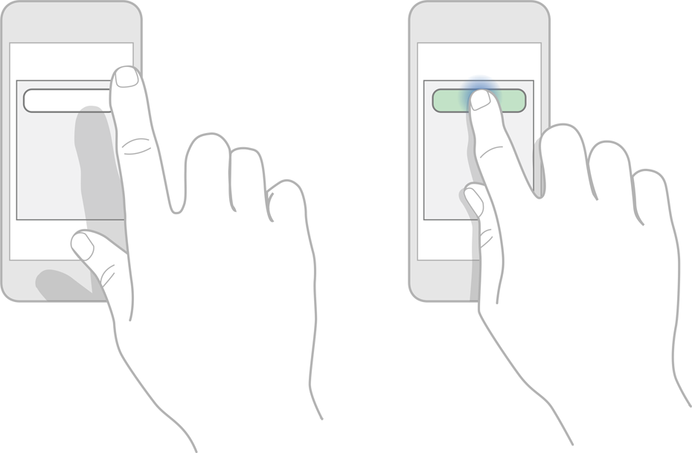
Feedback
Feedback acknowledges people’s actions, shows them the results, and updates them on the progress of their task.

Slide 38
App examples
Walmart
Pinterest
Uniqlo

Slide 39
Homework
Storyboard for your final term project
  Go to iTunes store and download 3 related Apps
  Dissect these Apps

Slide 40
~ END ~
http://www.alphacamp.tw

